Slide 1
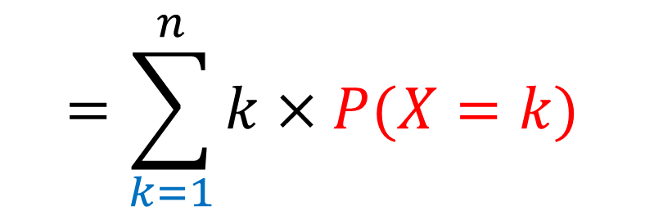
$$E\left(X\right)=\sum_{k=0}^{n}{k×P(X=k)}$$
$$k×P(X=k)$$
$$=\sum_{k=1}^{n}{k×P(X=k)}$$
$$=\sum_{k=1}^{n}{k×\left(\begin{matrix}n \\ k\end{matrix}\right)}p^{k}{\left(1−p\right)}^{n−k}$$
$$or k×\left(\begin{matrix}n \\ k\end{matrix}\right)=k×\frac{n!}{k!\left(n−k\right)!}$$

Slide 2
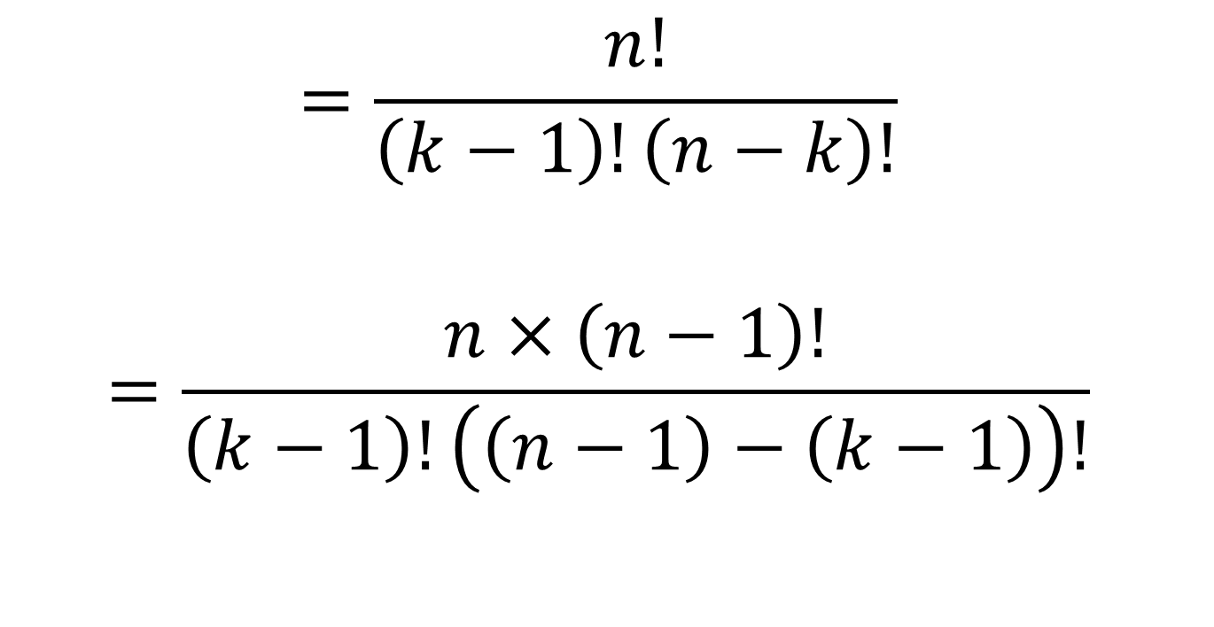
Or $k\left(\begin{matrix}n \\ k\end{matrix}\right)=k×\frac{n!}{k!\left(n−k\right)!}$
$$=\frac{n!}{\left(k−1\right)!\left(n−k\right)!}$$
$$=\frac{n×\left(n−1\right)!}{\left(k−1\right)!\left(\left(n−1\right)−\left(k−1\right)\right)!}$$

Slide 3

Ou encore $k\left(\begin{matrix}n \\ k\end{matrix}\right)=\frac{n×\left(n−1\right)!}{\left(k−1\right)!\left(\left(n−1\right)−\left(k−1\right)\right)!}$
$$=n\frac{\left(n−1\right)!}{\left(k−1\right)!\left(\left(n−1\right)−\left(k−1\right)\right)!}$$
$$=n\left(\begin{matrix}n−1 \\ k−1\end{matrix}\right)$$

Slide 4

$k\left(\begin{matrix}n \\ k\end{matrix}\right)=n\left(\begin{matrix}n−1 \\ k−1\end{matrix}\right)$

Slide 5
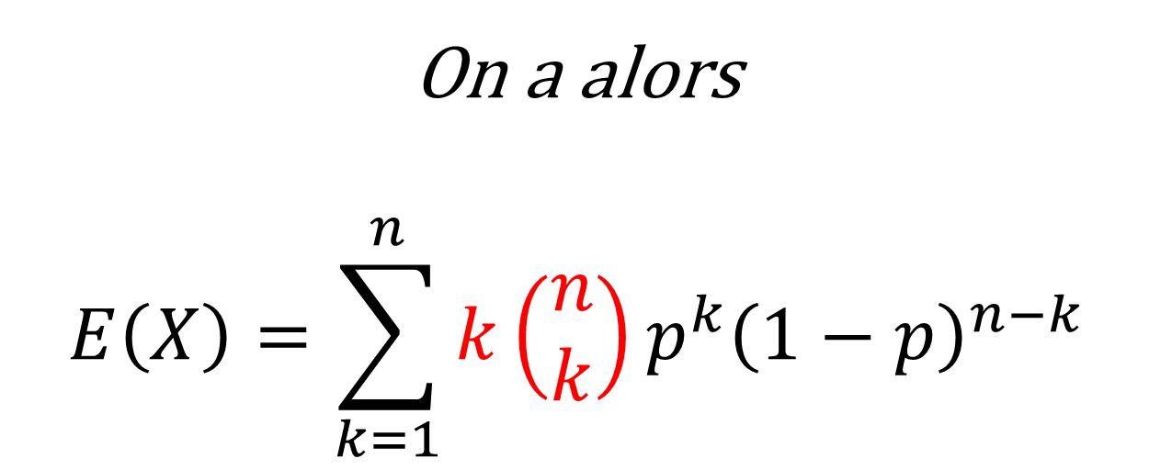
On a alors $$E\left(X\right)=\sum_{k=1}^{n}{k\left(\begin{matrix}n \\ k\end{matrix}\right)}p^{k}{\left(1−p\right)}^{n−k}$$
$$=\sum_{k=1}^{n}{n\left(\begin{matrix}n−1 \\ k−1\end{matrix}\right)}p^{k}{\left(1−p\right)}^{n−k}$$

Slide 6
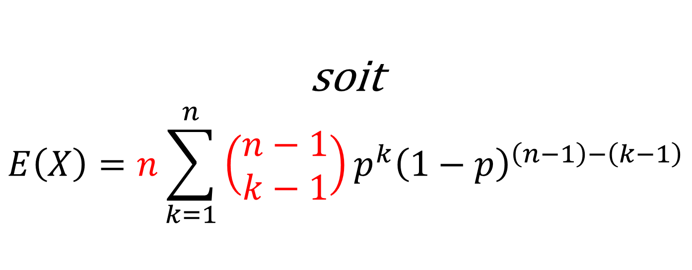
soit $$E\left(X\right)=n\sum_{k=1}^{n}{\left(\begin{matrix}n−1 \\ k−1\end{matrix}\right)}p^{k}{\left(1−p\right)}^{\left(n−1\right)−\left(k−1\right)}$$
$$=n\sum_{k=1}^{n}{\left(\begin{matrix}n−1 \\ k−1\end{matrix}\right)}{p×p}^{k−1}{\left(1−p\right)}^{\left(n−1\right)−\left(k−1\right)}$$

Slide 7
$$=n×p\sum_{k=1}^{n}{\left(\begin{matrix}n−1 \\ k−1\end{matrix}\right)}p^{k−1}{\left(1−p\right)}^{\left(n−1\right)−\left(k−1\right)}$$
$$=n×p\sum_{K=0}^{n−1}{\left(\begin{matrix}n−1 \\ K\end{matrix}\right)}p^{K}{\left(1−p\right)}^{\left(n−1\right)−K}$$

Slide 8
$$=n×p\sum_{K=0}^{n−1}{\left(\begin{matrix}n−1 \\ K\end{matrix}\right)}p^{K}{\left(1−p\right)}^{\left(n−1\right)−K}$$
$$=n×p\sum_{K=0}^{N}{\left(\begin{matrix}N \\ K\end{matrix}\right)}p^{K}{\left(1−p\right)}^{N−K}$$
$$=n×p×{\left(p+\left(1−p\right)\right)}^{N}$$
$$=n×p$$

