Slide 1
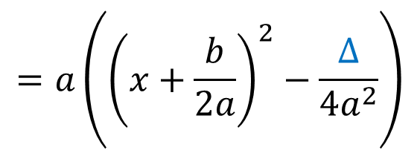
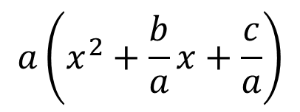
$$a\left(x^{2}+\frac{b}{a}x+\frac{c}{a}\right)$$
$$ax^{2}+bx+c=$$
$$=a\left(x^{2}+2×\frac{b}{2a}×x+\frac{c}{a}\right)$$
$$=a\left(x^{2}+2×\frac{b}{2a}×x+{\left(\frac{b}{2a}\right)}^{2}−{\left(\frac{b}{2a}\right)}^{2}+\frac{c}{a}\right)$$
$$=a\left(\left(x^{2}+2×\frac{b}{2a}x+{\left(\frac{b}{2a}\right)}^{2}\right)−\frac{b^{2}}{4a²}+\frac{4a×c}{4a×a}\right)$$
$$=a\left({\left(x+\frac{b}{2a}\right)}^{2}−\frac{b^{2}−4ac}{4a^{2}}\right)$$
On pose $Δ=b^{2}−4ac$
$$=a\left({\left(x+\frac{b}{2a}\right)}^{2}−\frac{Δ}{4a^{2}}\right)$$

